Slide 1


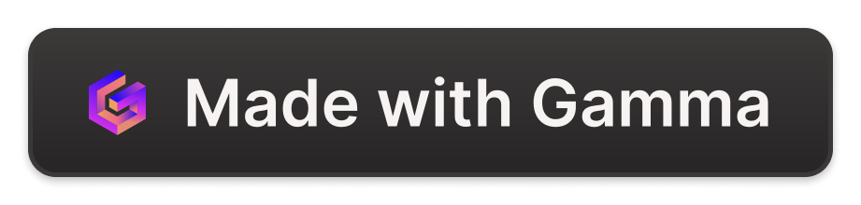
Sales Assistant AI: Streamlining the Customer Journey
Introducing an AI-powered Sales Assistant that seamlessly integrates with your sales process, providing invaluable insights and automating tedious tasks to help you close deals more efficiently.
by alun alun
aa

Slide 2



Digital Business Card Exchange
Effortless Card Capture
Automated Data Entry
Personalized Outreach
Leverage the AI to instantly digitize and catalog customer business cards, ensuring all relevant details are stored in your CRM.
The AI analyzes the card information and automatically updates your customer database, saving time and reducing errors.
With customer details at your fingertips, you can craft personalized follow-up messages to build stronger relationships.

Slide 3

Email Interaction Analysis
Email Summary
Intelligent Responses
Product Recommendations
The AI reviews past email conversations, providing you with a concise summary of the key points, action items, and customer sentiment.
Leveraging the AI's natural language processing, you can generate tailored, professional email responses to keep the conversation flowing.
Based on the customer's needs and preferences, the AI suggests relevant products or services that could benefit them, helping you make more informed proposals.

Slide 4




Meeting Summaries and Proposals
Meeting Notes
The AI transcribes your in-person meetings, providing a detailed summary of the discussion and action items.
Proposal Generation
Using the meeting insights, the AI can generate personalized proposals that address the customer's specific needs and concerns.
Next Steps
The AI recommends the optimal timing and content for your follow-up communication, ensuring a seamless customer experience.

Slide 5

Relationship Building
1
Dinner Invitation
Leverage the AI's insights to suggest the perfect venue and timing for an enjoyable dinner with your client, strengthening the personal connection.
2
Expense Tracking
The AI automatically logs the dinner expenses and associates them with the customer, ensuring accurate accounting and compliance.
3
Follow-up Coordination
Based on the dinner discussions, the AI recommends the optimal time and content for your next follow-up, maintaining momentum and building trust.

Slide 6
Closing the Deal
1
Proposal Refinement
2
Personalized Pitches
The AI fine-tunes your proposal based on the latest customer interactions, ensuring it addresses their specific needs and concerns.
Leverage the AI's insights to craft tailored pitches that resonate with the customer, highlighting the unique value your solution provides.
3
Objection Handling
4
Deal Closure
The AI anticipates potential objections and suggests effective responses, empowering you to address customer concerns with confidence.
With the AI's guidance, you can seamlessly navigate the final stages of the sales process and secure the deal, celebrating your success.

Slide 7
Continuous Improvement
Customer Insights
The AI's ongoing analysis of customer interactions provides valuable insights that enable you to refine your sales strategies and better serve your clients.
Workflow Optimization
By automating repetitive tasks and streamlining your sales process, the AI helps you and your team work more efficiently, freeing up time for higher-value activities.
Performance Tracking
The AI tracks key sales metrics and provides data-driven recommendations to help you and your team continuously improve your performance.

Slide 8
Empowering Your Sales Team
Increased Productivity
Personalized Recommendations
By automating administrative tasks and providing intelligent insights, the AI-powered Sales Assistant frees up your team's time to focus on building stronger customer relationships and closing more deals.
The AI's deep understanding of customer preferences and behavior enables it to suggest the most appropriate products, services, and sales strategies for each unique customer scenario.
Consistent Excellence
Competitive Advantage
With the AI's guidance, your sales team can maintain a high level of customer service and sales excellence, delivering a seamless and memorable experience for every client.
By leveraging the power of AI, your sales organization can stay ahead of the curve, making data-driven decisions and responding to customer needs with unparalleled speed and precision.

